Slide 1
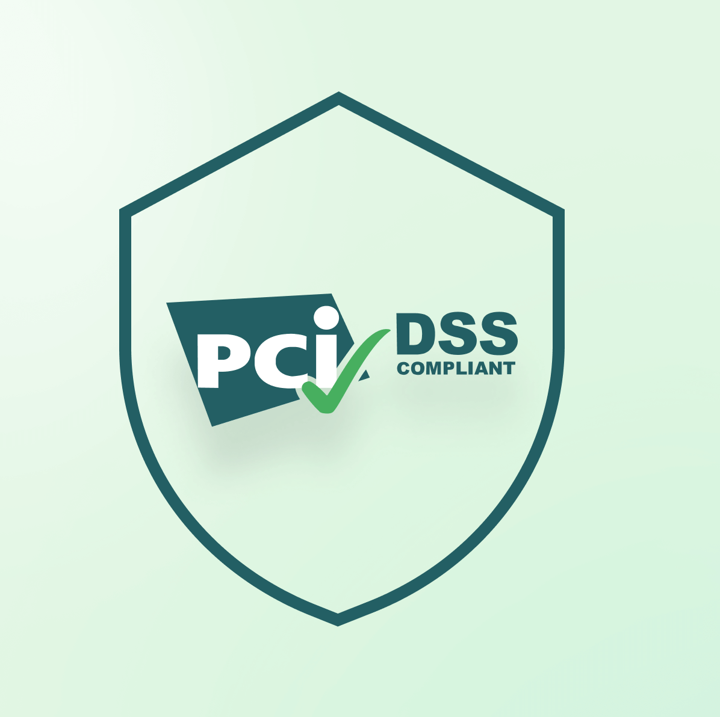
PCI DSS – Payment Card Industry Data Security

Slide 2
Introduction
PCI DSS stands for Payment Card Industry Data Security Standard.
Founded in 2004 by leading credit card companies: Visa, MasterCard, Discover Financial Services, JCB International, and American Express.
PCI DSS is overseen by the Payment Card Industry Security Standards Council (PCI SSC).
The primary aim of PCI DSS is to protect credit and debit card transactions against fraud and information theft.
It sets a unified standard for securing payment card data.

Slide 3
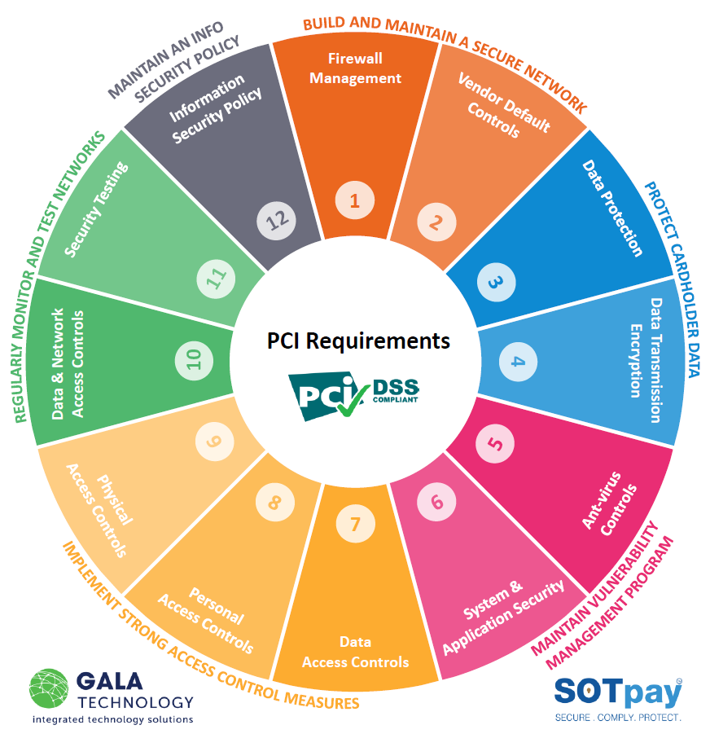
PCI DSS Requirements
Secure Network:
Install and maintain a secure firewall.
Avoid using default passwords.
Protect Cardholder Data:
Securely store cardholder data.
Encrypt data during transmission.
Vulnerability Management:
Protect systems against malware.
Develop and maintain secure systems and applications.
Access Control:
Restrict access based on need-to-know.
Verify and limit access.
Control physical access.
Monitoring and Testing:
Continuously monitor access.
Regularly test security systems.
Information Security Policy:
Maintain an information security policy.

Slide 4
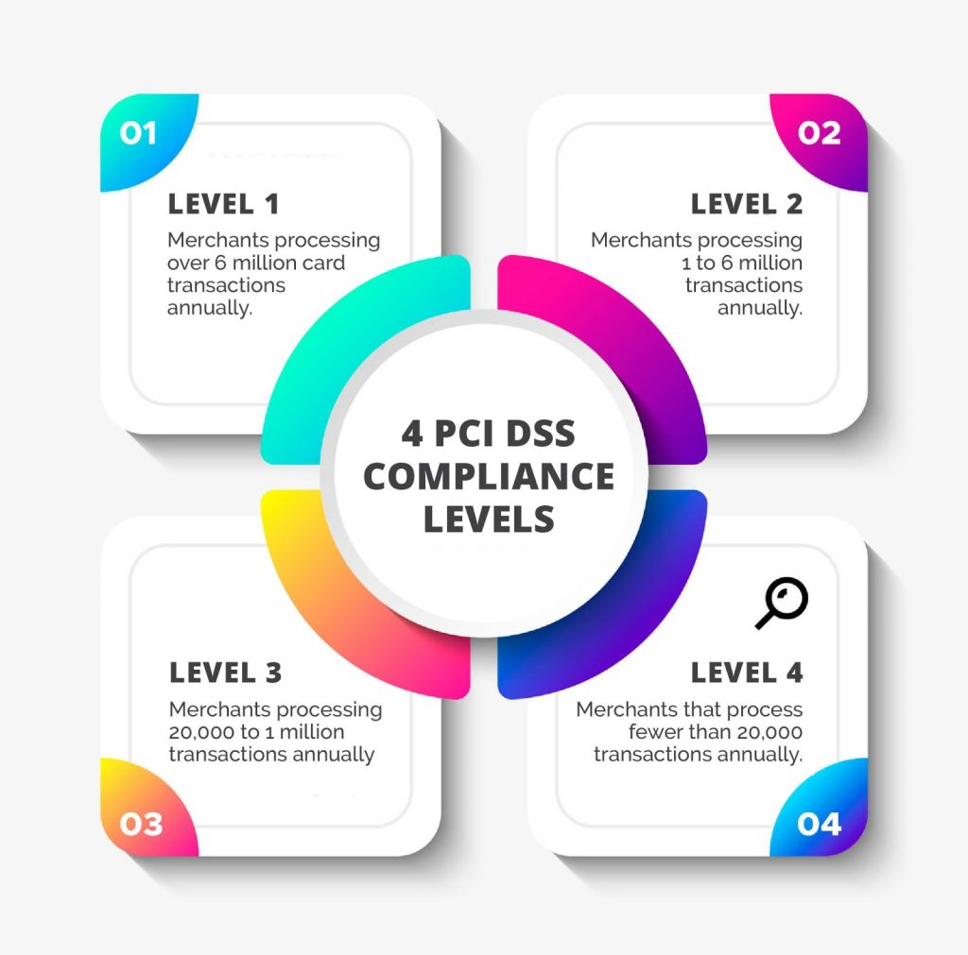
PCI DSS Compliance Levels
Compliance Levels:
Level 1:
Typically applies to merchants processing over 6 million Visa transactions per year.
Requires an annual on-site assessment by a Qualified Security Assessor (QSA).
Level 2:
Applies to merchants processing between 1 million and 6 million Visa transactions annually.
Requires a yearly self-assessment questionnaire (SAQ) and quarterly network scans.
Level 3:
Applies to merchants processing 20,000 to 1 million Visa e-commerce transactions annually.
Requires a yearly SAQ and quarterly network scans.
Level 4:
Applies to merchants processing less than 20,000 Visa e-commerce transactions annually and all other merchants processing up to 1 million Visa transactions.
Requires an annual SAQ and quarterly network scans.

Slide 5

Applicability Information
Cardholder
Primary Account Number (PAN)
Cardholder name
Expiration date
Service Code
Sensitive Authentication
Full track data (strip or chip)
Card verification code
PINs

Slide 6
Importance of PCI Compliance
Protecting data and preventing fraud.
Preparing organizations to combat threats.
Boosting customer confidence in card payments.
Providing a security benchmark.
Improving operational efficiency.
Reducing the penalty for data breaches.

Slide 7
Consequences Of Noncompliance
Acquirer Action:
Your acquirer (the bank or financial institution) may prohibit you from accepting card payments.
This can lead to a significant loss in revenue and customer trust.
Non-Compliance Fees:
Non-compliance can result in costly fines and penalties.
These fees can add up and impact your bottom line.
Data Misuse and Fraud:
Unprotected data can be misused or stolen, leading to fraud.
Customers' personal and financial information may be compromised.
Monetary Penalties:
Legal expenses, banking fines, and government audit costs can be substantial.
Forensic investigations and data cleanup are also expensive.
Loss of Trust:
Noncompliance erodes trust among clients, partners, and major financial institutions.
This loss of trust can have long-term consequences for your business.

Slide 8

Compliance Best Practices
Regular Audits:
Conduct internal and external security audits.
Use qualified assessors for assessments and penetration testing.
Employee Training:
Train staff on security and PCI DSS requirements.
Ensure everyone understands their compliance roles.
Data Encryption:
Encrypt sensitive data at rest and in transit.
Use compliant encryption solutions.
Access Control:
Enforce strict access control measures.
Limit access to authorized personnel only.
Patch Management:
Keep systems and software updated with security patches.
Regularly review and update security configurations.
Incident Response:
Develop and maintain an incident response plan.
Ensure efficient incident handling procedures.
Network Segmentation:
Segment networks to isolate cardholder data.
Reduce the scope of compliance requirements.
Vendor Oversight:
Assess third-party vendors' PCI DSS compliance.
Verify their adherence to security standards when handling cardholder data.

Slide 9
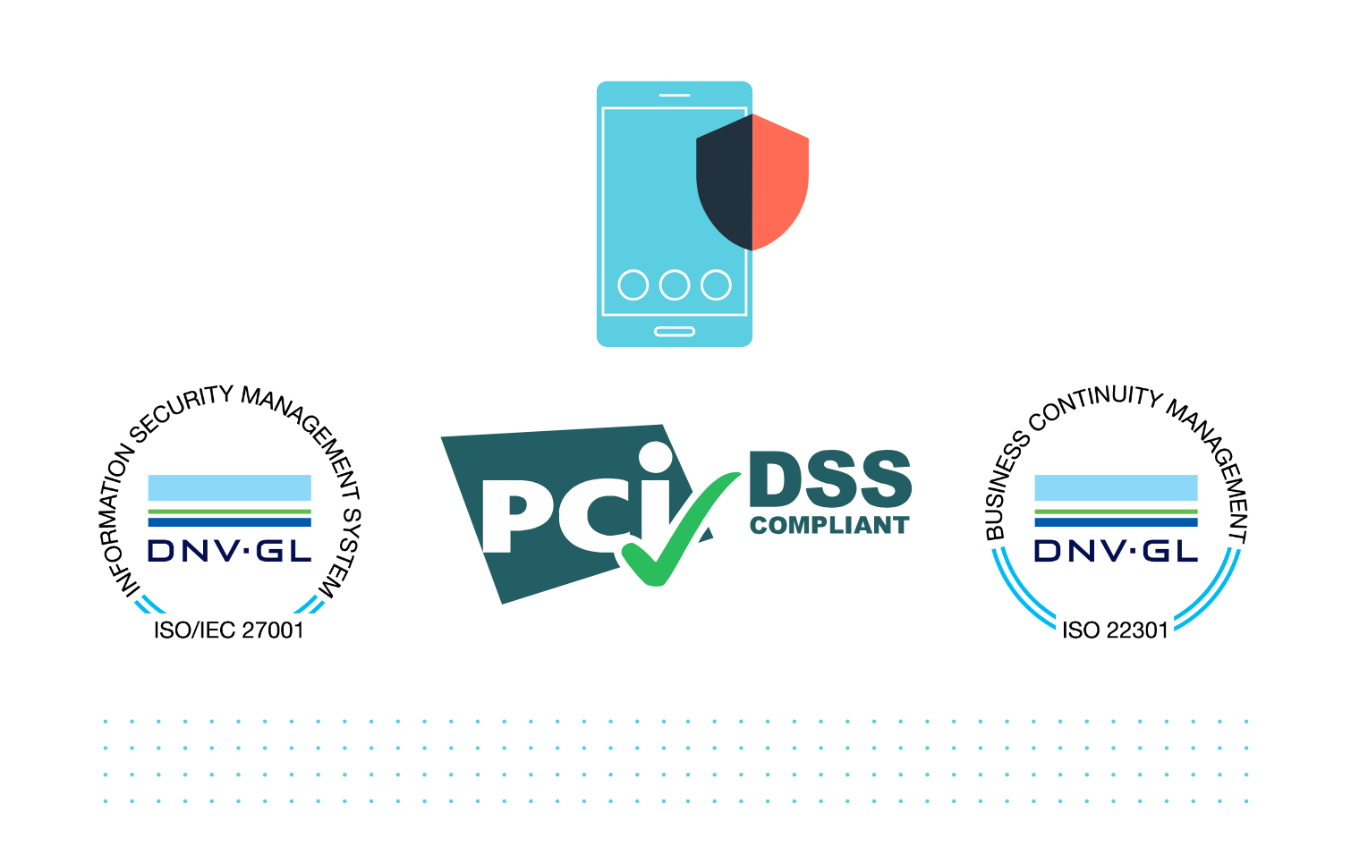
Conclusion
PCI DSS compliance is not just a requirement; it's an essential investment in your organization's security and reputation.
By adhering to PCI DSS standards, you safeguard sensitive cardholder data, build trust, and mitigate risks.
Compliance isn't a one-time effort but an ongoing commitment to maintaining strong security practices.
Key Takeaways
Protect Your Business: PCI DSS safeguards your business from data breaches and fraud.
Build Trust: Compliance earns trust from customers, partners, and financial institutions.
Ongoing Vigilance: Maintain compliance with continuous audits and best practices.

